Slide 1
Meet the teacher!
Welcome to Year 1
Stoats Class.
Wednesday 23rd September 2026

Slide 2
Meet the Team
Mrs Easteal – Wednesday, Thursday and Friday
Mrs Fairley – Monday and Tuesday
Mrs Beckerleg – Mornings Monday to Thursday and Thursday afternoon
Mrs Rigden and Mrs Haley – other afternoons

Slide 3
A Typical Day in Year 1
Early morning work and register
Assembly
Reading groups –Tuesday, Wednesday and Thursday
Maths
Breaktime
Phonics
English
Lunch time
Quiet reading
2 Foundation subject lessons
Home time

Slide 4
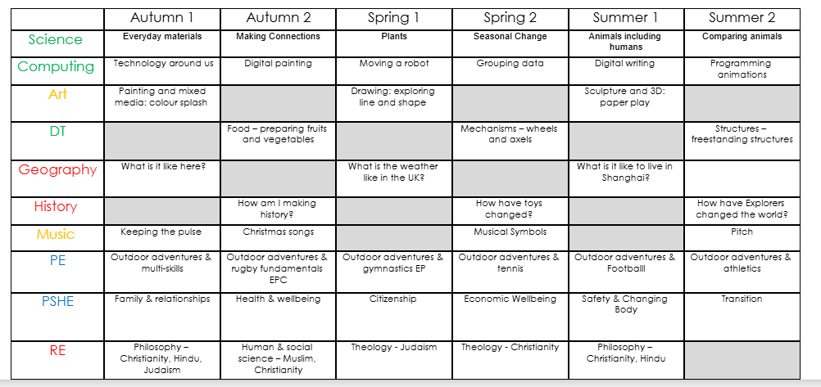
Curriculum Overview

Slide 5
Homework in Year 1
Monday
Homework folders sent home – phonic and spellings
Thursday
Reading books sent home – to be returned the following Wednesday
Friday
Return homework folders - Spellings tested.

Slide 6
Behaviour and Rewards
School behaviour policy
Class rewards – gems for house points
Star awards and kindness awards
Fish philosophy
Times tables awards
Spelling awards
Attendance - Friday spin the wheel for 100%/Biscuit Bear

Slide 7
Assessment and Progress
Ongoing – daily assessment
Phonic and reading assessments half termly – data helps to spot gaps and set up interventions
Formal assessment PiXL – start in Spring Term for Year 1 in Maths and Reading.

Slide 8
Phonic Screening
Will take place week in early June – date to follow
We would really appreciate all endeavours to be in school during this week.

Slide 9
Important Information
Forest School is on a WEDNESDAY afternoon
Reminder: children need old clothes with arms and legs covered, waterproofs and layers in winter
PE is currently on a TUESDAY afternoon – this may change half-termly, we will ensure to give you plenty of notice.
Uniform reminders: Long hair tied back and bring a coat please. Please remove earrings on PE days.

Slide 10
Communication
On the gate – please feel free to speak to any member of staff on the gate if available
General enquiries to the office
admin@tendring-pri.essex.sch.uk

Slide 11
Thank you for your ongoing support.
How you can help:
Read daily with your child
Practise spelling words, phonic sounds and tricky words.
Encourage any writing
Talk about numbers

Slide 12
Thank you for your ongoing support.
Any questions?

